Slide 1
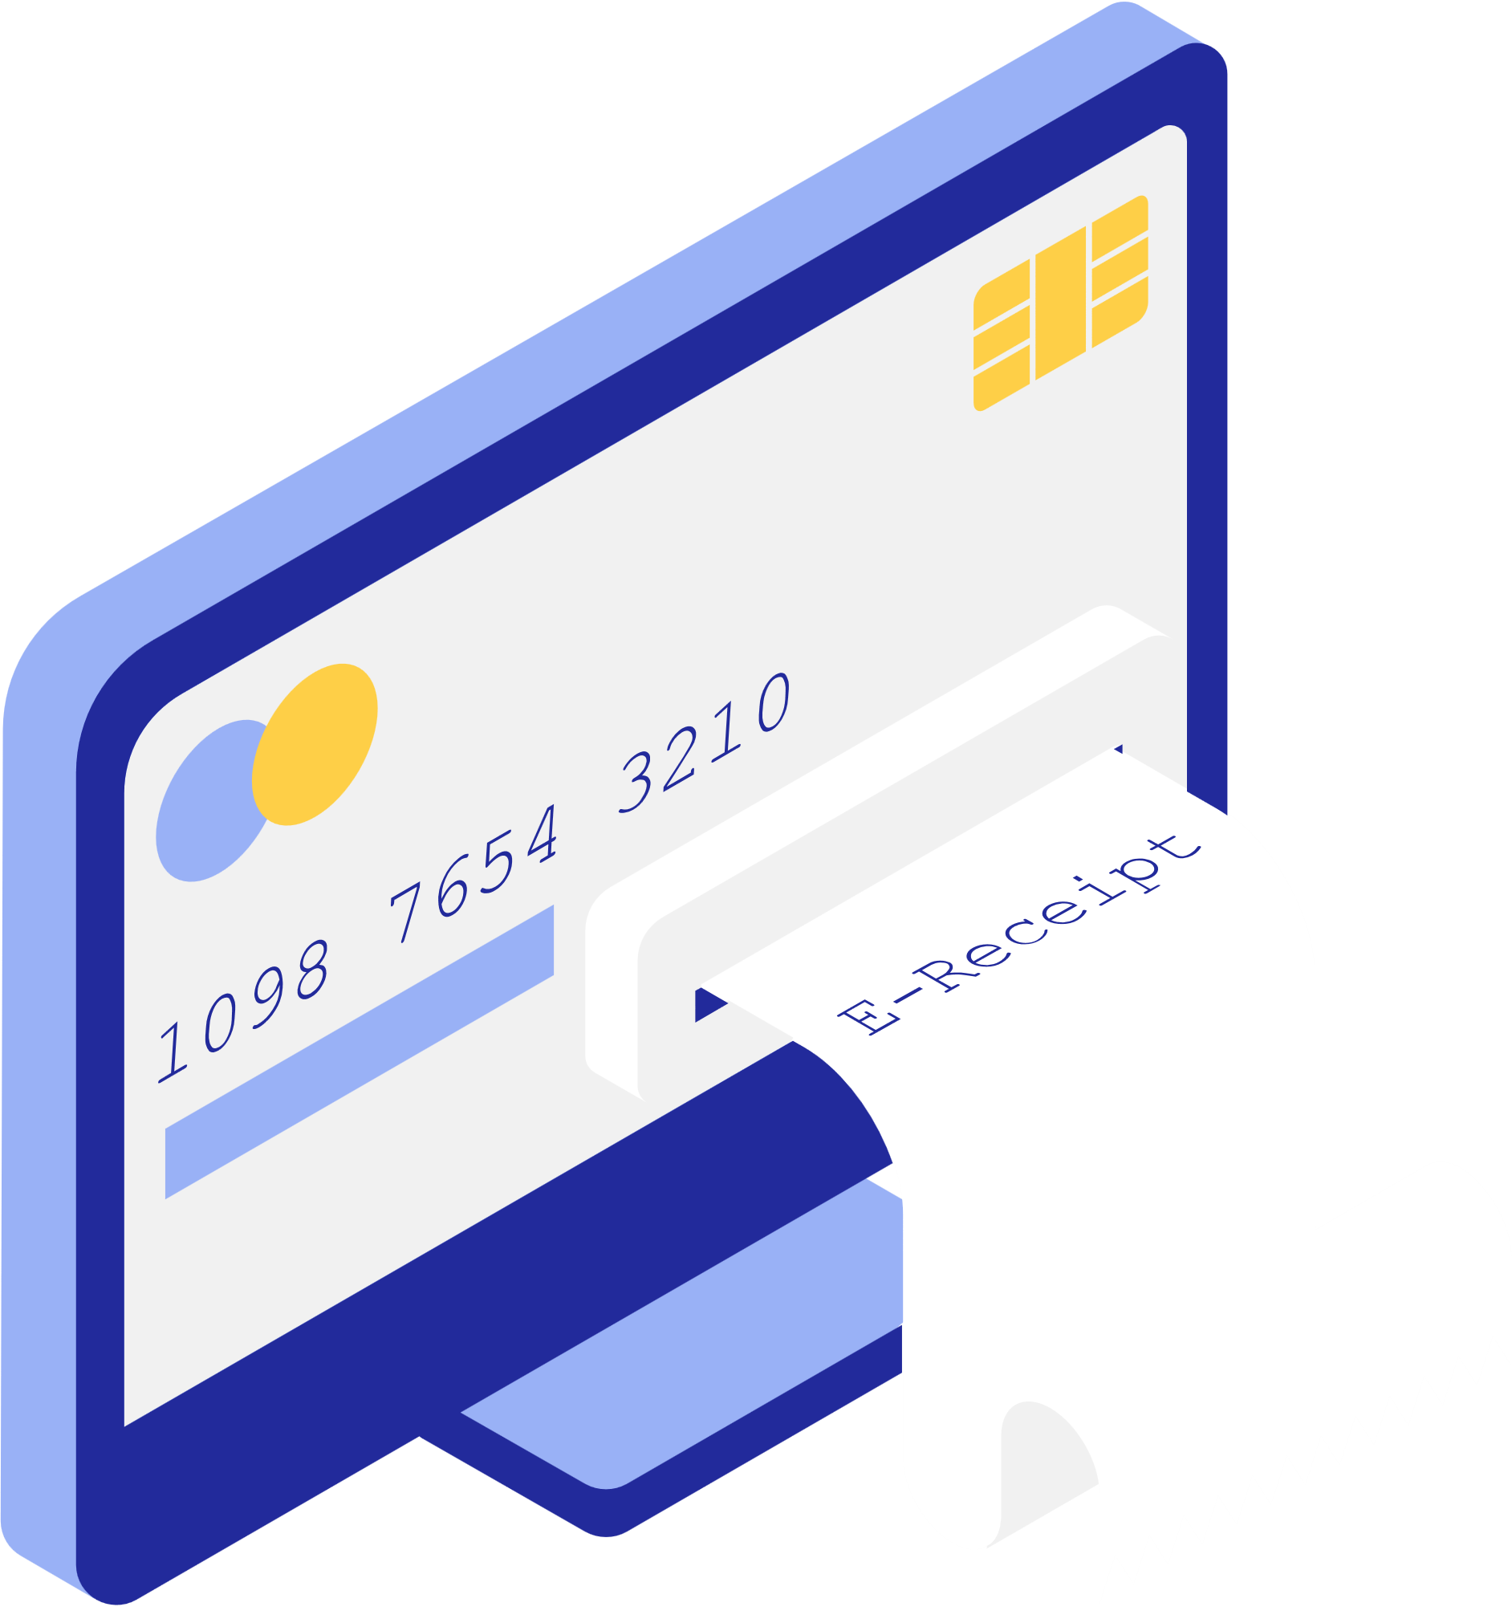


BANK
MANAGEMENT SYSTEM

Slide 2


SUBMITTED BY
SUBMITTED TO
S.M. Rashidul Hasan Nijhum
Harun
221002138
Lecturer
Green University of Bangladesh

Slide 3

TOPICS
1. Introduction
2. Motivation
3. Objectives
4. Proposed solution
5. Implementation
6. Features
7. Conclusion

Slide 4

INTRODUCTION
Bank Management System is a system that enables the Banks to manage information and data related to all aspects of deposit, withdrawal, handle and more which in turn ensures that the processes are completed swiftly, securely and effectively.

Slide 5
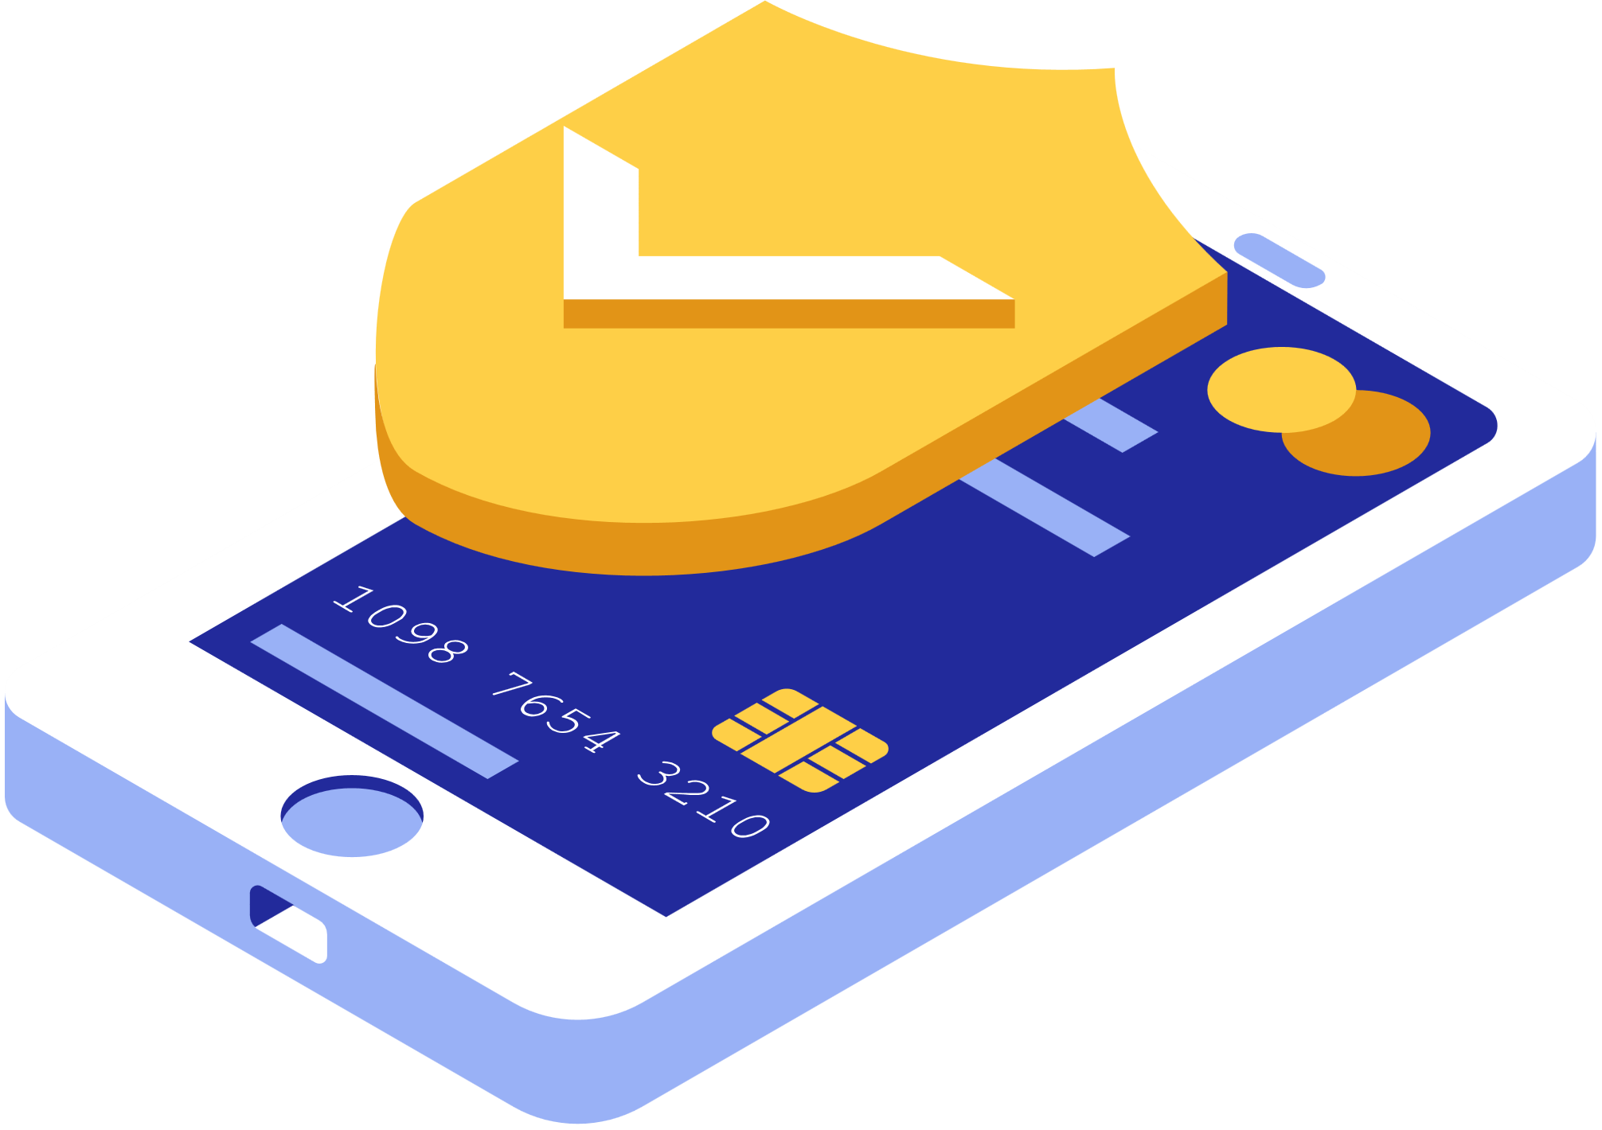
MOTIVATION
•To meet a solution to manage bank records.
•To overcome exixting problems that is occurring to maintain bank informations.

Slide 6
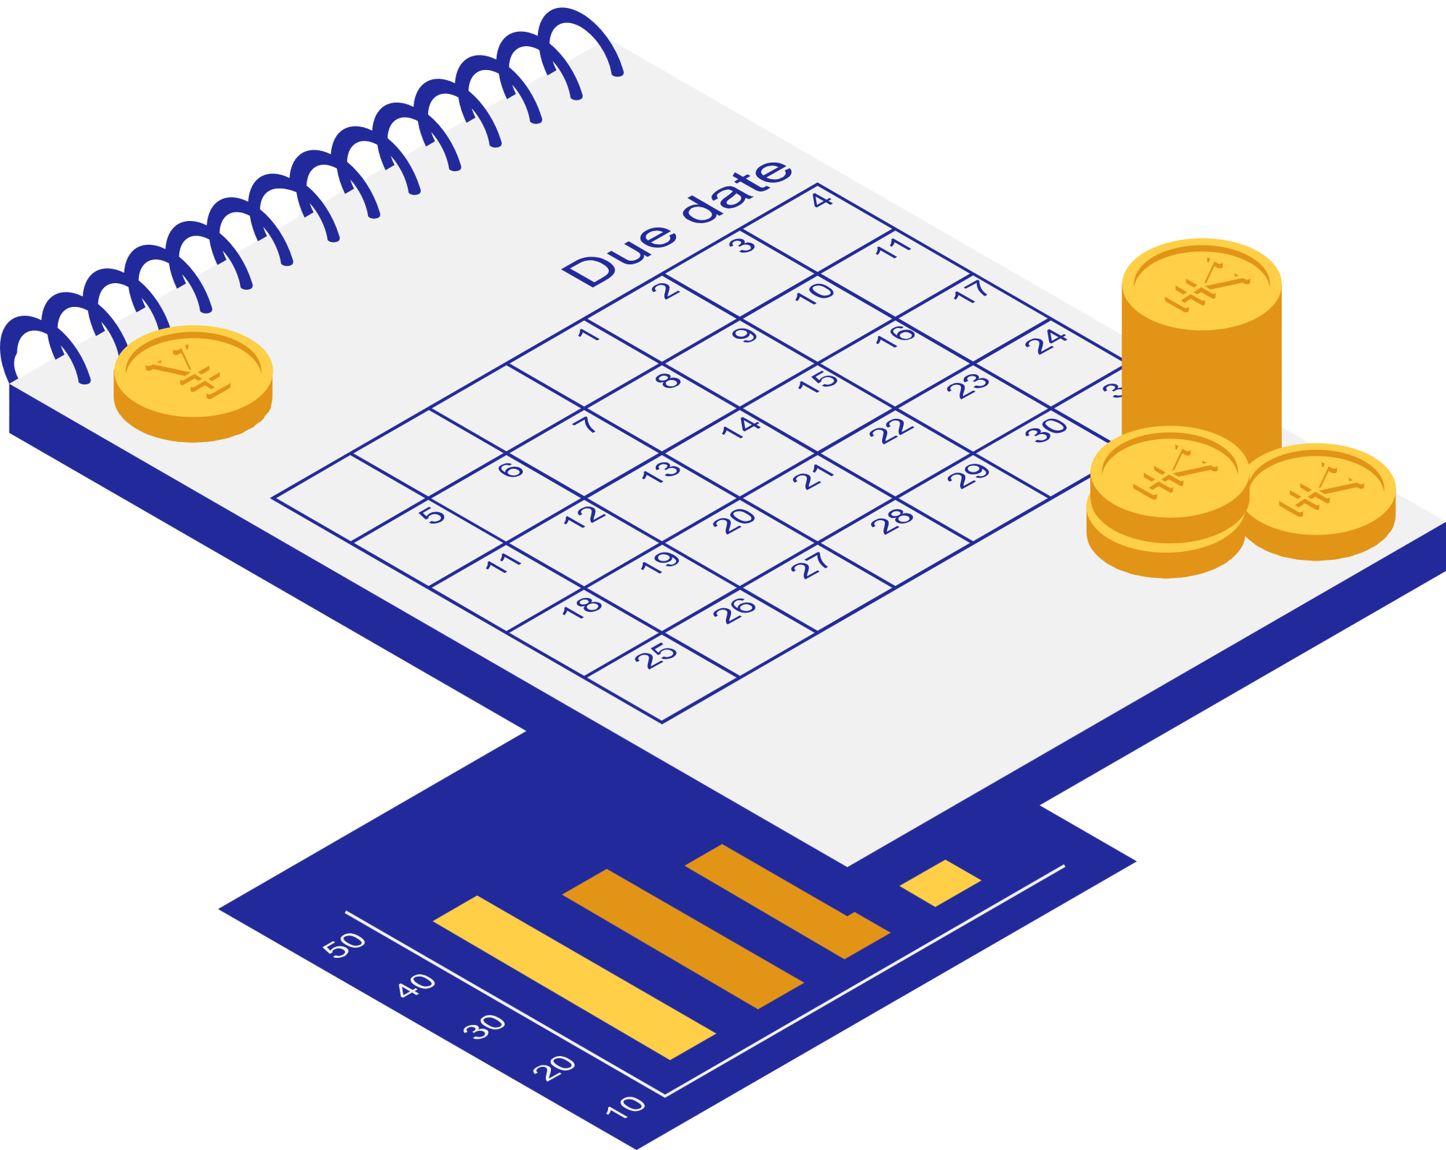
OBJECTIVES
To make all the Bank facilities secure for everyone.
To make the Bank related services easier and even better.
To create a simple and user-friendly interface for the bank administrator.
To make a fast, flawless, reliable and easy system for Banks.
To learn the usage of advanced C language Data Structure concepts.

Slide 7

PROPOSED SOLUTION
Administration Login
Main Menu
Main Menu
Create Acc.
Update
Transition
Search
View List
Remove
Create Acc.
Update
Transition
Search
Remove
View List
Exit
Exit

Slide 8
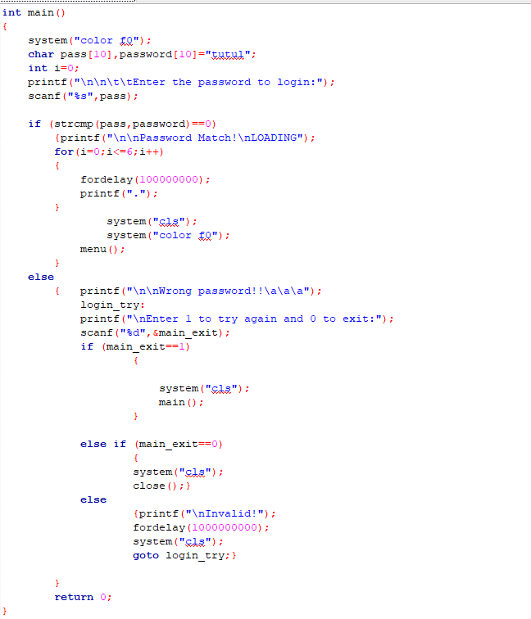
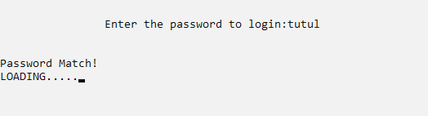
IMPLEMENTATION

Slide 9
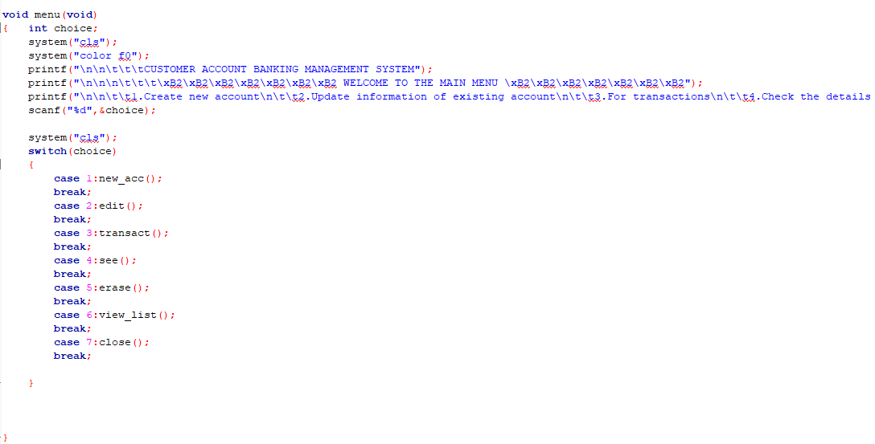
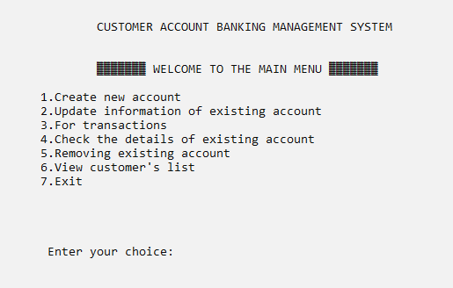
IMPLEMENTATION

Slide 10
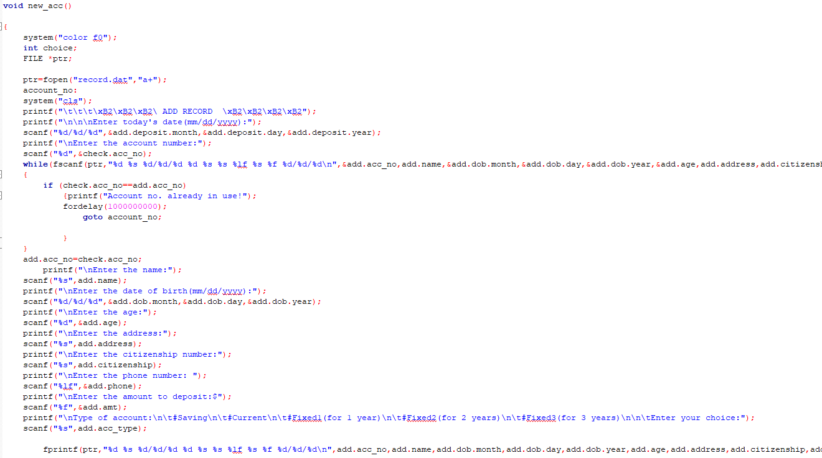
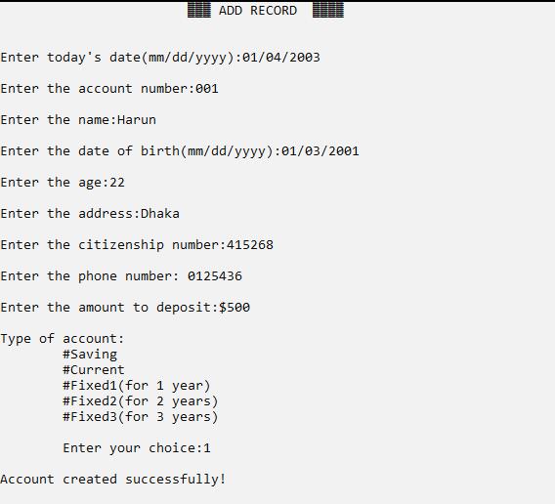
IMPLEMENTATION

Slide 11
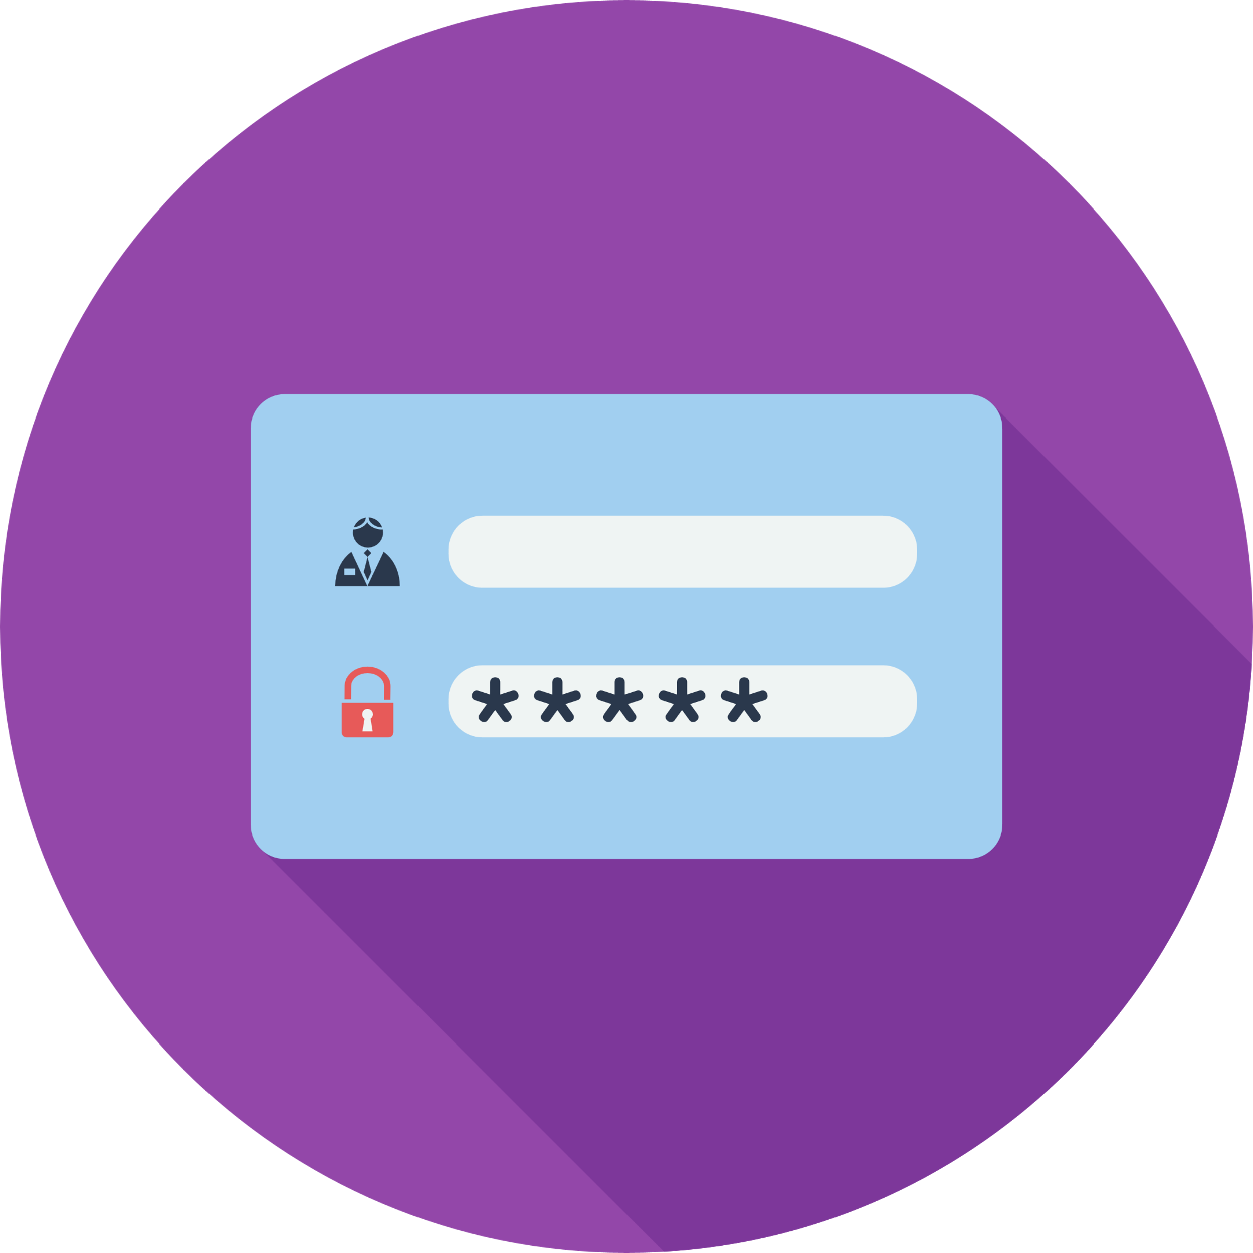


FEATURES
1. LOG IN
2. USER-FRIENDLY
3. SECURITY

Slide 12
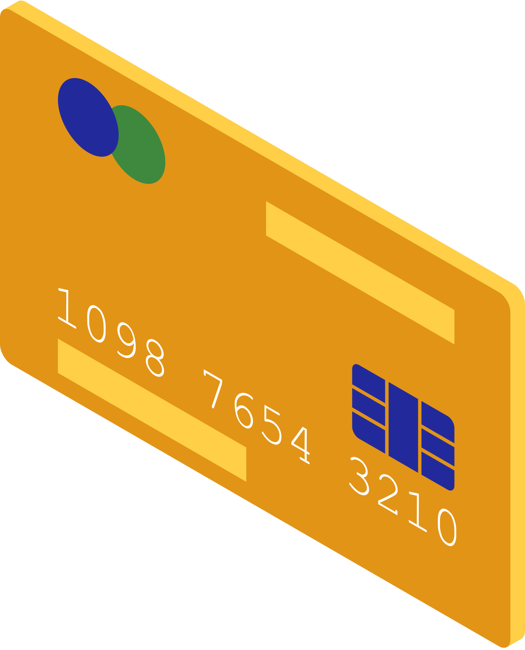
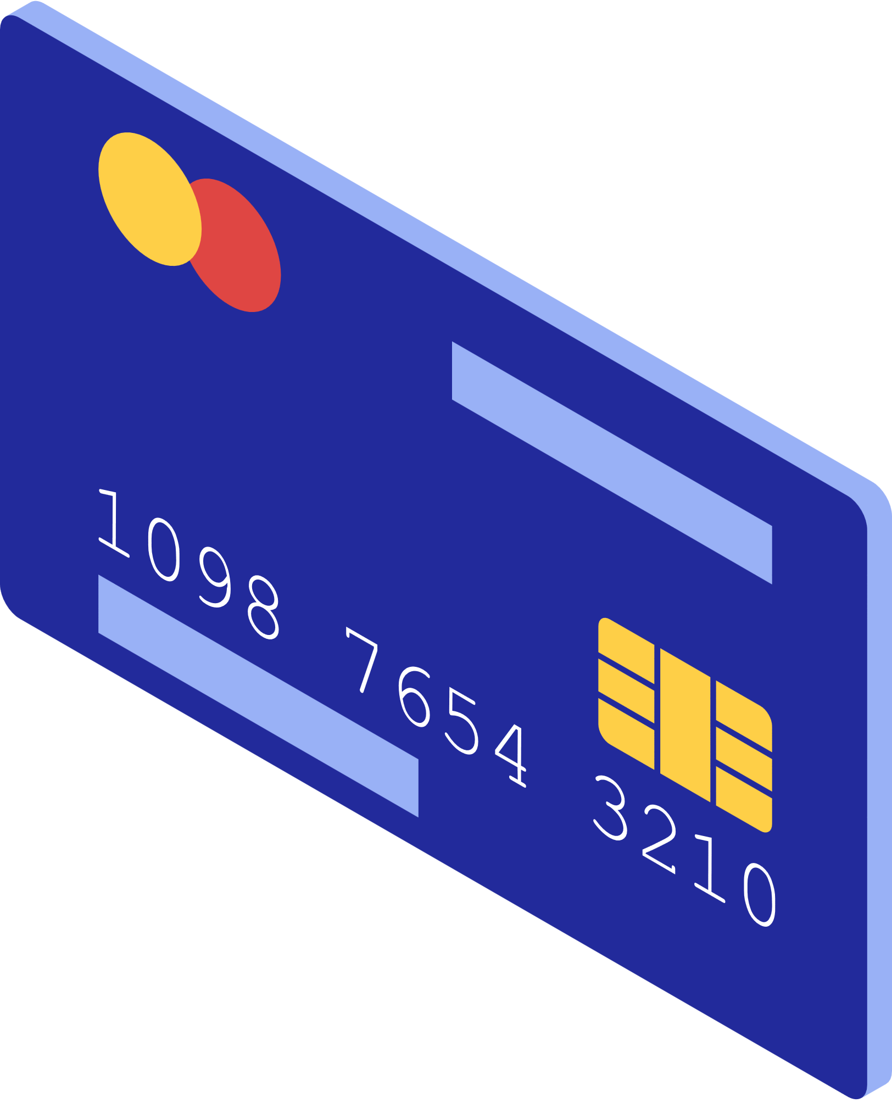
CONCLUSION
The purpose of this program is to make all the Bank related services secure because sometimes important data hacked by hackers for the lack of security of the used low-quality system..
There are a lot of future work scopes with the program, such as:
● The program can be used to create a complete mobile or desktop app.
● UI design can be added to the program to make it aesthetically more beautiful.
● This program can be transferred to another advanced programming language to do advanced work.
● This project can be made into an actual management system which can be used in bigger sectors.
● There is still a lot of work that can be done to make the program more advanced and more functional in future.

Slide 13

ANY
QUESTION?

Slide 14

THANK YOU

